Slide 1
Computer Organization and Architecture
INSTRUCTION EXECUTION CYCLE

Slide 2
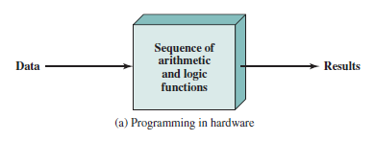
Programming in Hardware

Slide 3
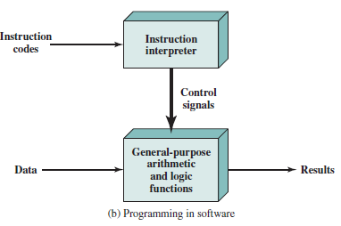
Programming in Software

Slide 4

Structure of von Neumann machine
Notes:
Main memory storing programs and data
Control unit interprets instructions from memory and executes them
ALU operates on binary data
Input and output equipment operated by control unit

Slide 5
von Neumann/Turing
Completed 1952
Three key concepts:
  Data and instructions are stored in a single read–write memory
  The contents of this memory are addressable by location, without regard to the type of data contained there
  Execution occurs in a sequential fashion from one instruction to the next.

Slide 6
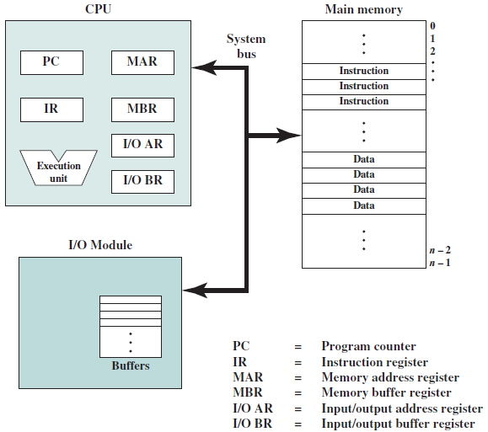
Top-level Components -details
Notes:
Two registers are essential in memory write and read operations: the memory data
register (MDR) and memory address register (MAR). The MDR and MAR are used
exclusively by the CPU and are not directly accessible to programmers.
The CPU exchanges data with memory *
*using MAR(specifies the address in memory for the next read or write) and MBR(contains data to be written to memory or received from memory).
Similarly IO/AR specifies devices and IO/BR specifies data to be exchanged.

Slide 7
Instruction Cycle
PROGRAM EXECUTION

Slide 8

Instruction Cycle
Two steps:
  Fetch
  Execute
Notes:
Task of processor is to execute instructions. Processing required for a single instruction is called instruction cycle.
Read one at a time from memory.
Instruction execution involves several operations

Slide 9
Fetch Cycle
Program Counter (PC) holds address of next instruction to fetch
Processor fetches instruction from memory location pointed to by PC
Increment PC
  Unless told otherwise
Instruction loaded into Instruction Register (IR)
Processor interprets instruction and performs required actions
Notes:
Four categories of actions are specified on the next slide

Slide 10
Execute Cycle
Processor-memory
  data transfer between CPU and main memory
Processor I/O
  Data transfer between CPU and I/O module
Data processing
  Some arithmetic or logical operation on data
Control
  Alteration of sequence of operations
  e.g. jump
combination of above
Notes:
Execution may involve combination of above actions

Slide 11
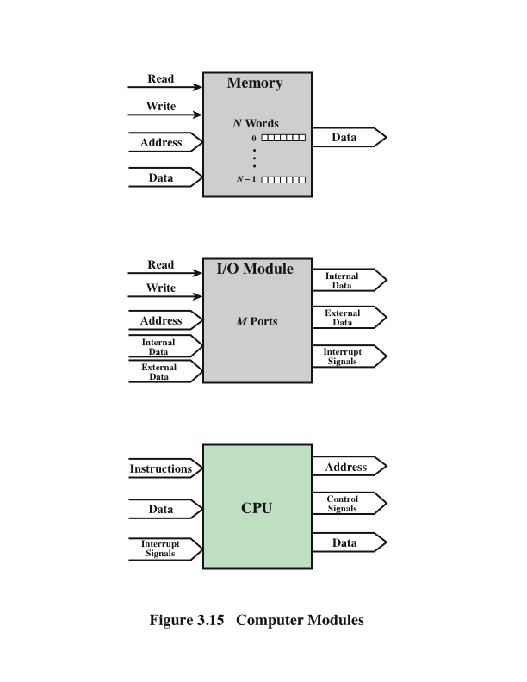

Slide 12
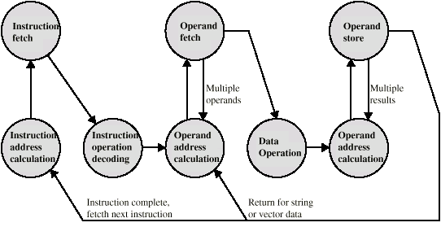
Instruction Cycle - State Diagram
Notes:
For any given instruction cycle, some states may be null and others may be visited more than once.
States in the upper half part involve exchange between processor and (memory or IO).
States in lower half part involve internal processor operations.

Slide 13
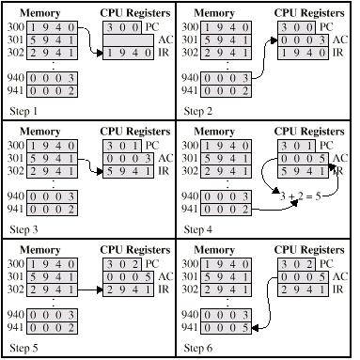

Example of Program Execution

Slide 14
Interrupts
Virtually all computers provide a mechanism by which other modules (I/O, memory) may interrupt or halt the normal processing of the processor
Interrupt is just a signal that provides an efficient way to handle unanticipated events
Can be generated by hardware or software

Slide 15
Types of Interrupts
Mechanism by which other modules (e.g. I/O) may interrupt normal sequence of processing
Program
  e.g. overflow, division by zero, reference outside memory
Timer
  Generated by internal processor timer
  Used in multi-tasking
I/O
  from I/O controller to request for service or indicate completion of task
Hardware failure
  e.g. power failure
Notes:
Virtually all computers provide a mechanism by which other modules (I/O, memory)
may interrupt the normal sequence of execution.
Several classes of interrupts
Interrupts are provided primarily as a way to improve processing efficiency.
For example, most external devices are much slower than the processor. Suppose
that the processor is transferring data to a printer using the instruction cycle scheme
of Figure 3.3. After each write operation, the processor must pause and remain
idle until the printer catches up. The length of this pause may be on the order of
many hundreds or even thousands of instruction cycles that do not involve memory.
Clearly, this is a very wasteful use of the processor.

Slide 16
Interrupts
The normal execution of the current program must be interrupted – the device raises an interrupt signal
Interrupt-service routine
Current system information backup and restore (PC, general-purpose registers, control information, specific information)

Slide 17
Interrupt Cycle
Added to instruction cycle
Processor checks for interrupt
  Indicated by an interrupt signal
If no interrupt, fetch next instruction
If interrupt pending:
  Suspend execution of current program
  Save context(i.e. state of program)
  Set PC to start address of interrupt handler routine
  Process interrupt
  Restore context and continue interrupted program

Slide 18

Instruction Cycle with Interrupts

Slide 19
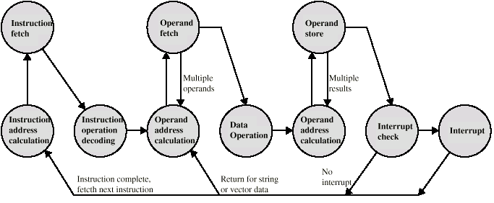
Instruction Cycle (with Interrupts) -
State Diagram

Slide 20

Transfer of Control via Interrupts

Slide 21
Multiple Interrupts
Disable interrupts
  Processor will ignore further interrupts whilst processing one interrupt
  Interrupts remain pending and are checked after first interrupt has been processed
  Interrupts handled in sequence as they occur
Define priorities
  Low priority interrupts can be interrupted by higher priority interrupts
  When higher priority interrupt has been processed, processor returns to previous interrupt

Slide 22

Multiple Interrupts - Sequential

Slide 23
Multiple Interrupts – Nested
Notes:
priorities for interrupts allow an interrupt of higher priority to cause a lower-priority interrupt handler to be itself
interrupted (Figure 3.13b).

